Slide 1

Stage 7 Kilroy Was Here Course Designer: Eric Beerbaum
Kilroy Was Here is a 24 round, 120 point Comstock long course. There are 12 USPSA targets. The best two hits per target will score. The start signal is audible.
The Handgun start position is standing outside shooting area with toes touching marks and wrists below belt. Handgun loaded and holstered. The PCC start position is standing outside shooting area with toes touching marks. PCC loaded with stock touching belt and muzzle pointed down range.
On the audible start signal, engage all targets from within the shooting area.

Slide 2
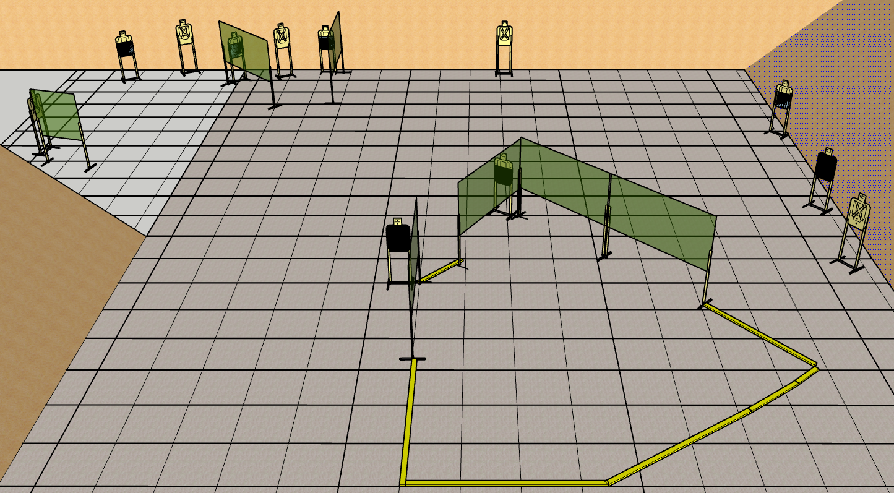
 | Renton Fish and Game Bay 7 Kilroy Was Here Course Designer: Eric Beerbaum

